Slide 1
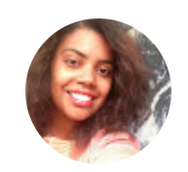
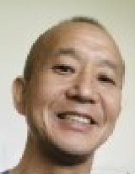
Contents:
Montessori Record Xpress (MRX)
What’s MRX
Why MRX
How to login
How to see the cumulative report
Student Activity & Video Library
Contact and Support
MRX Summary
<Prepared by: MGRI Parent MRX Liaison>

Slide 2
Montessori Record Xpress (MRX):
The Purpose
To help parents understanding the lessons and tracking of the progress

Slide 3
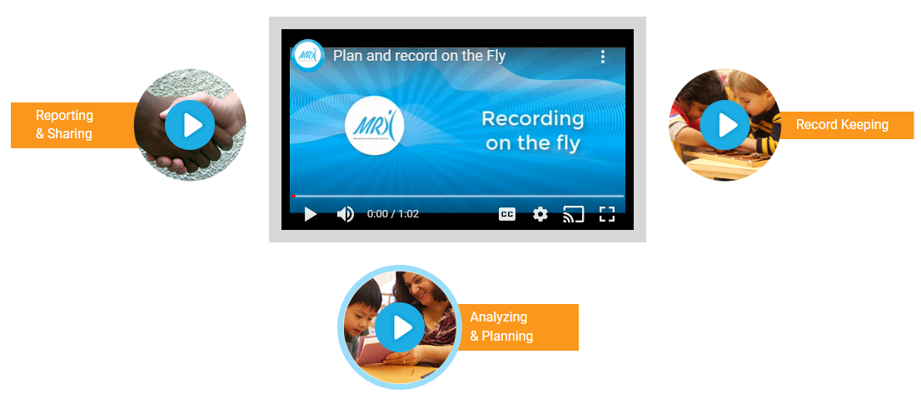
What’s MRX?
A record keeping/sharing tool for the lessons that the child has been presented, practiced, and mastered.

Slide 4
Why MRX?
Teachers can quickly log each child's activities and plan the future lessons in accordance with the Montessori program.
Parents can view the activities anytime.
→MRX has a useful lesson demo videos in the library as well.

Slide 5
Ready to explore MRX?

Slide 6
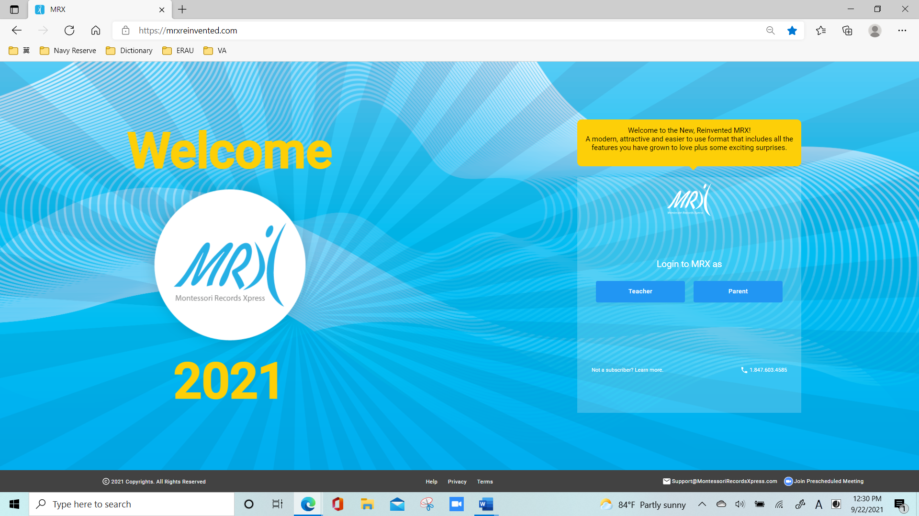
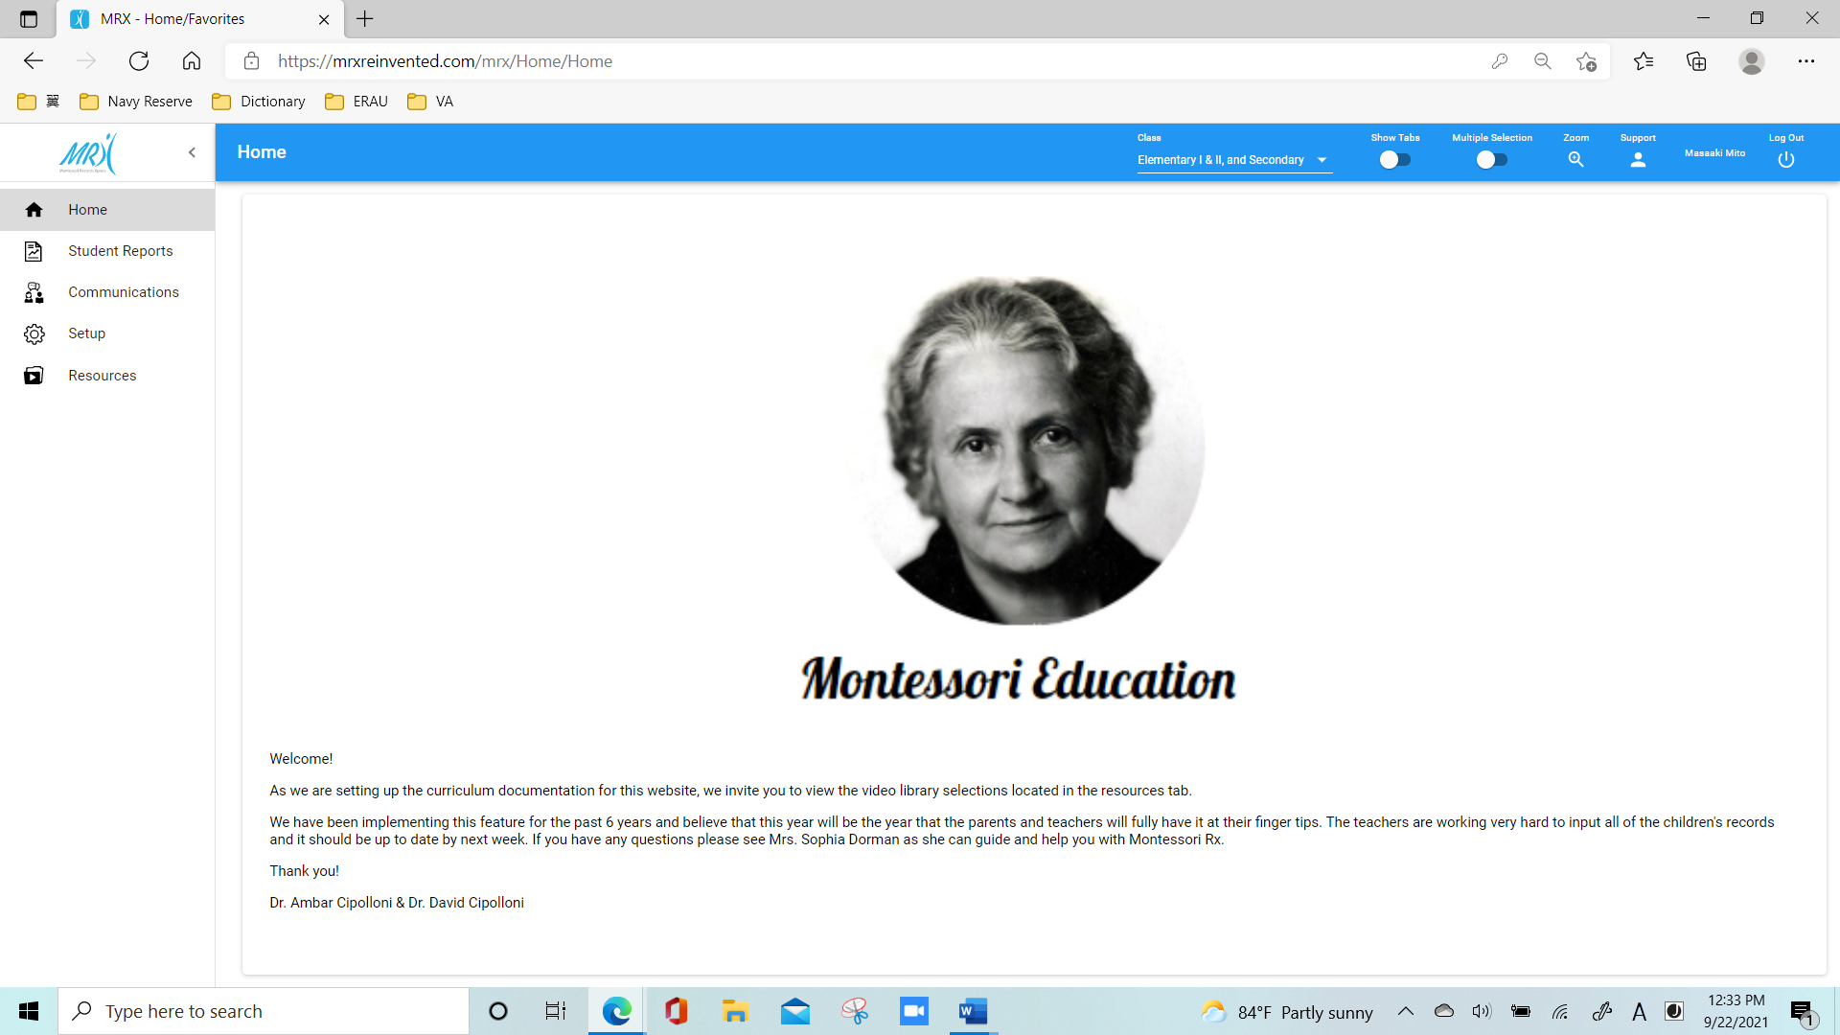
How to login:
Receive login info from school.
Expected to be sent by Sep 16, 2022

Slide 9
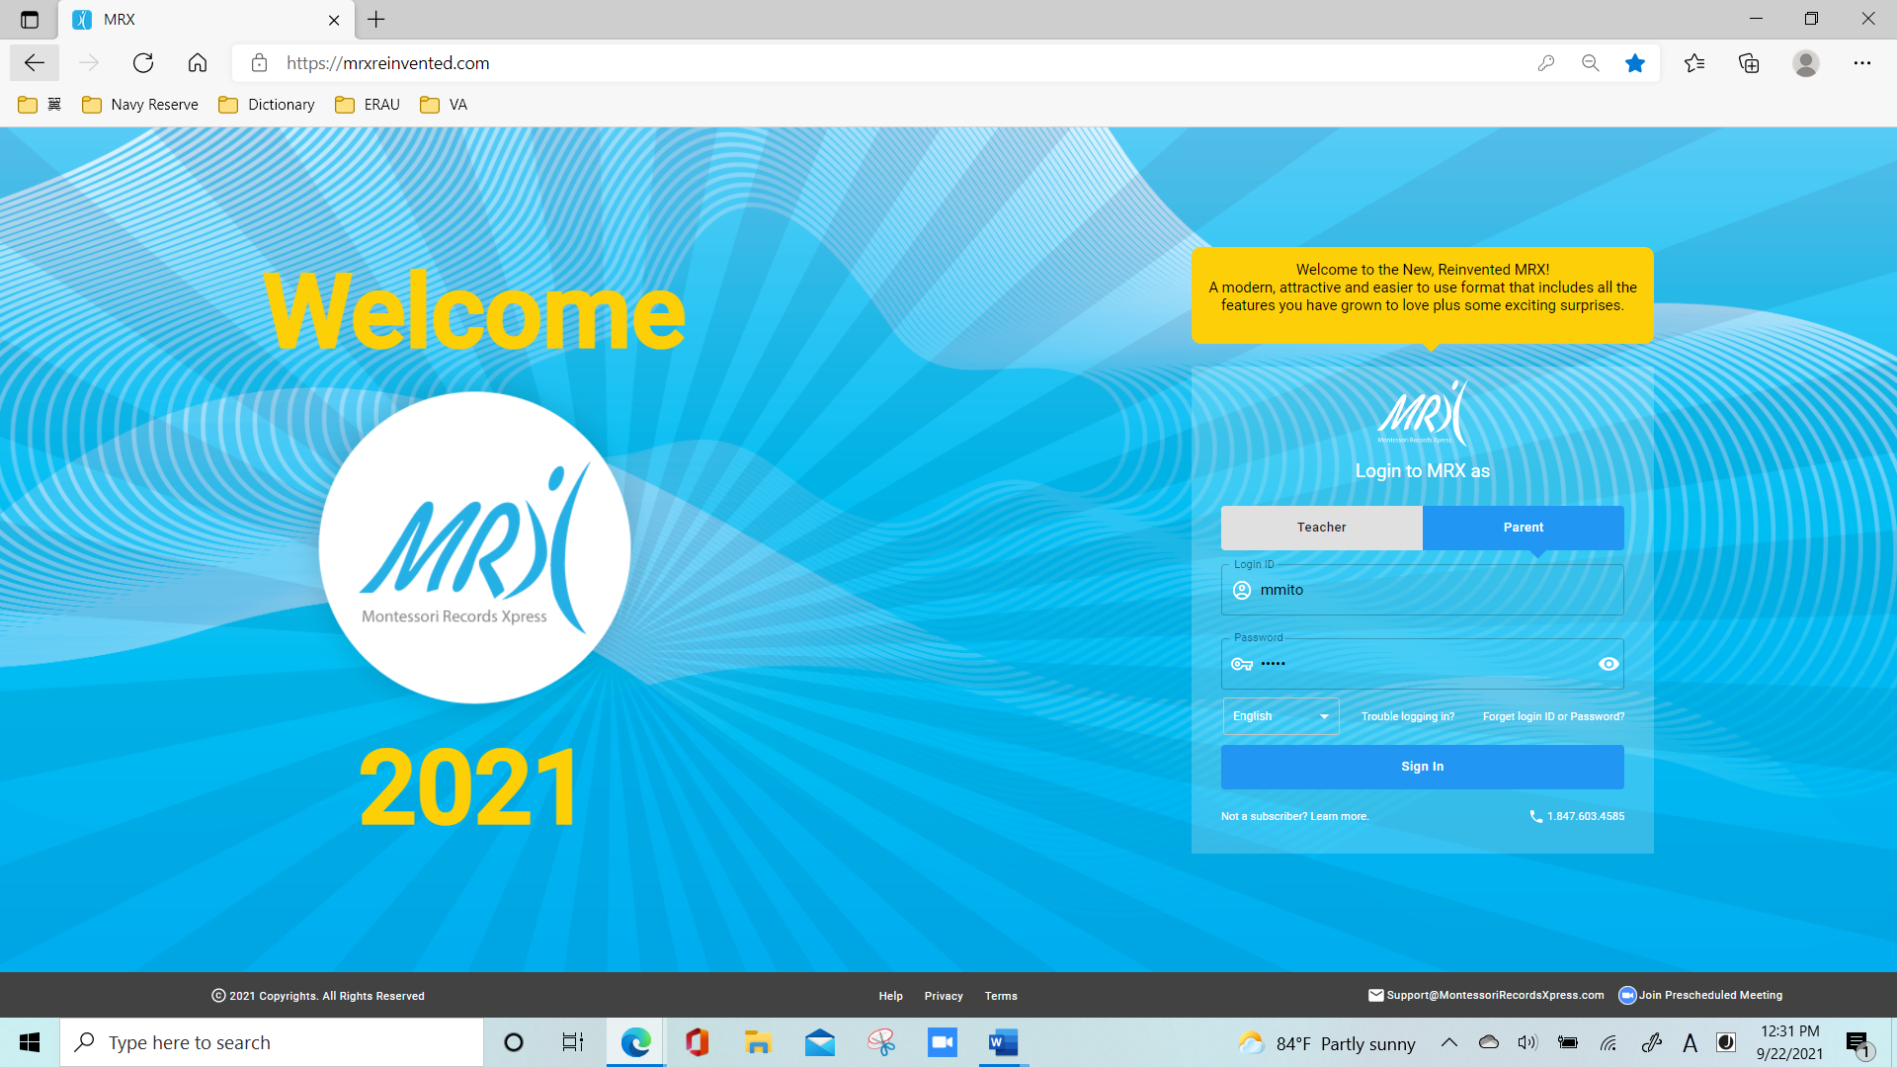
Type

Slide 10
Click

Slide 12
Login
Complete!

Slide 13
[To Set or Change Password]
Visit MRXreinvented.com
Click "Parent" on the right.
Below the Password field, click "Forget login ID/password?".
Follow the instruction
Enter the password you would like.
Click "Back to login".
These steps will come in handy if in the future you forget your password!

Slide 14
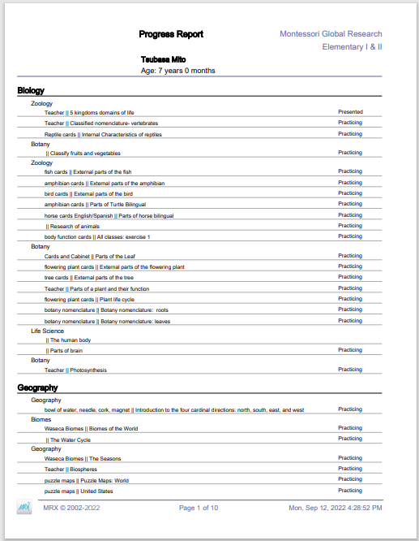
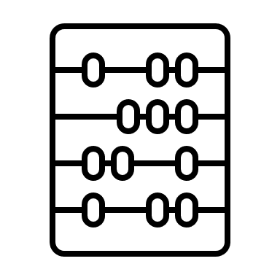
Cumulative (Progress) Report

Slide 15
Cumulative (Progress) Report
Most comprehensive and up-to-date academic report
It is highly suggested parents go there and see:
-What the child has done
-When it's been presented, practiced, and mastered

Slide 16
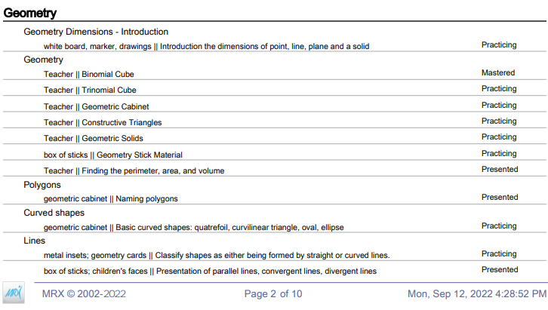
Cumulative (Progress) Report

Slide 17
Cumulative (Progress) Report

Slide 18
Cumulative (Progress) Report:
How to go there

Slide 19
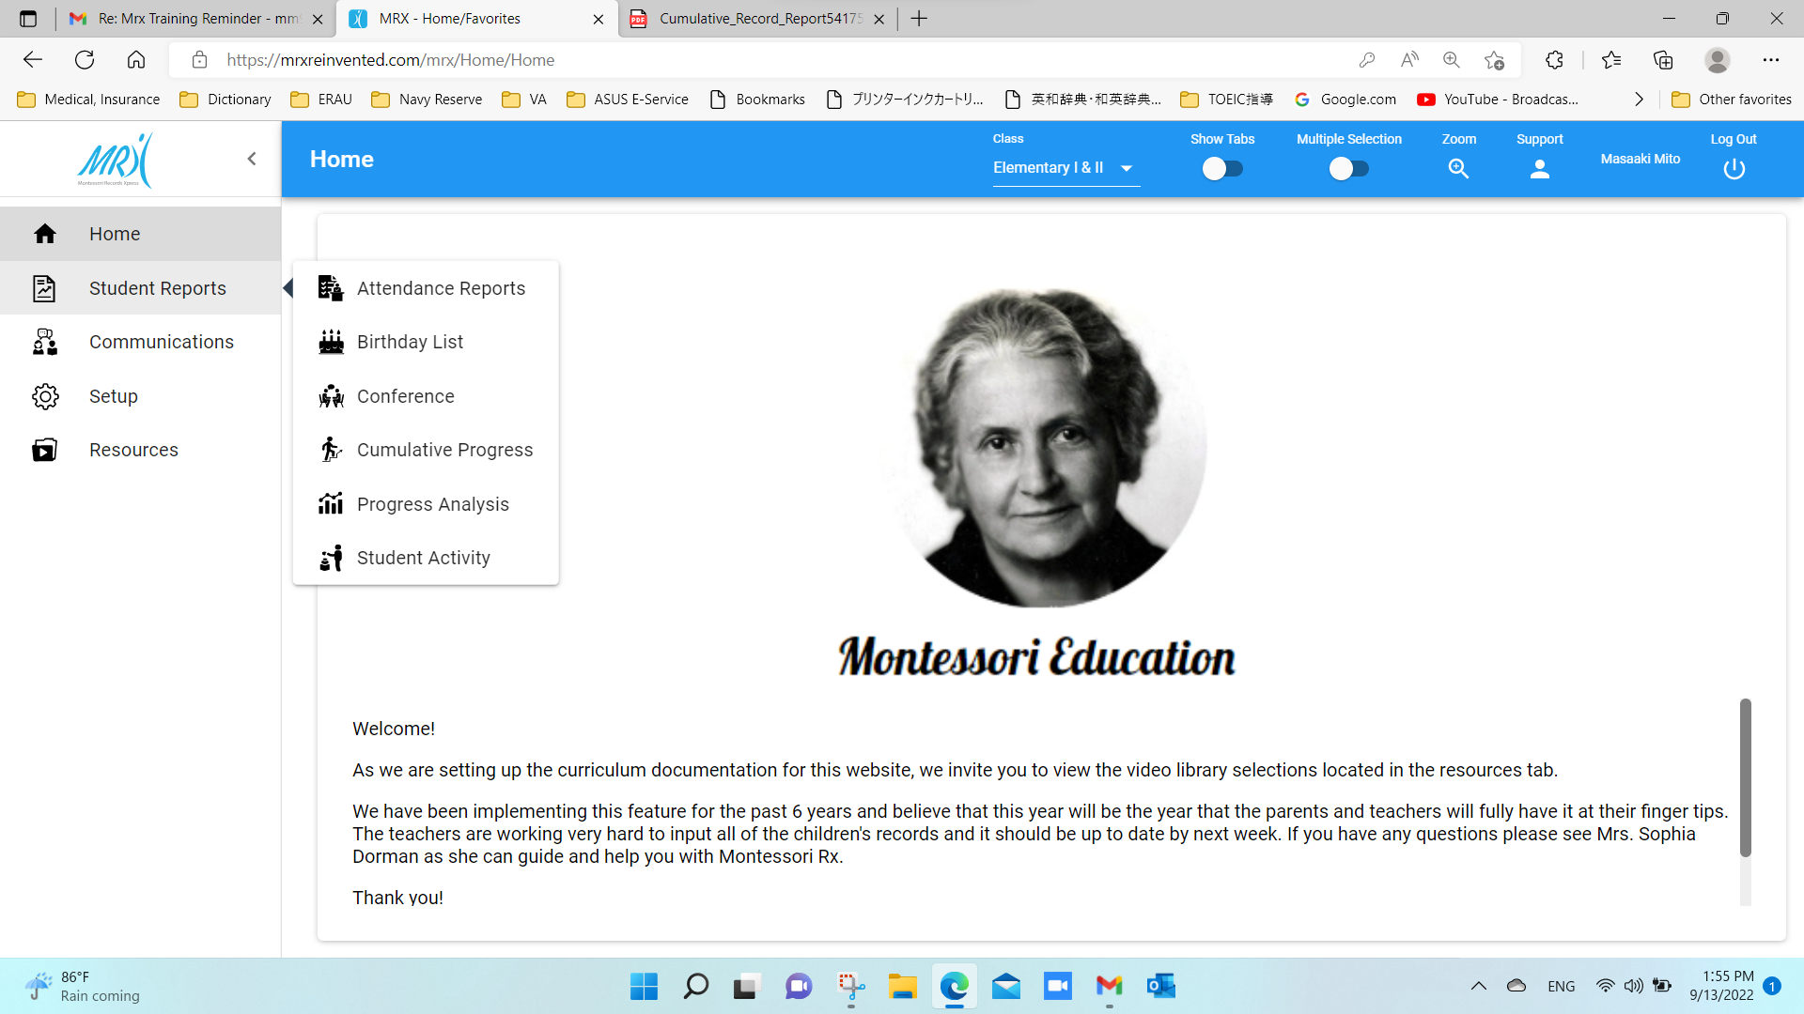
Mouse over
Click

Slide 20
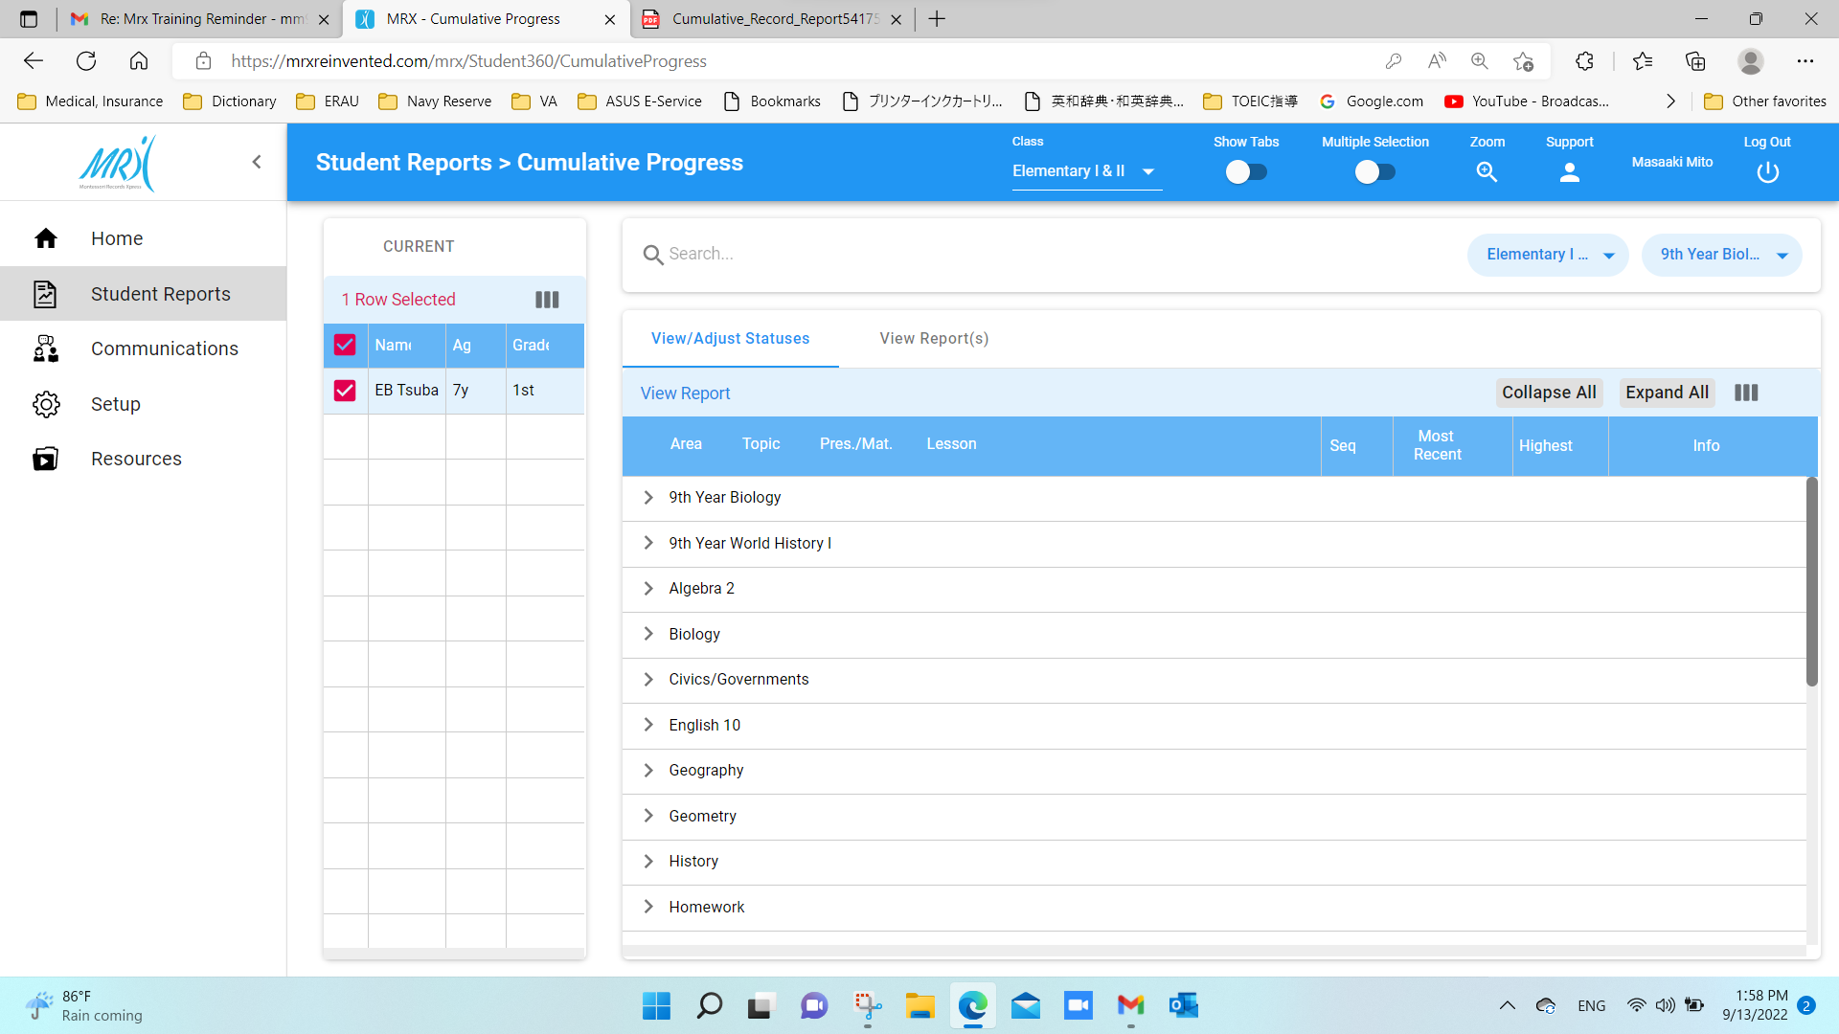
Click

Slide 21
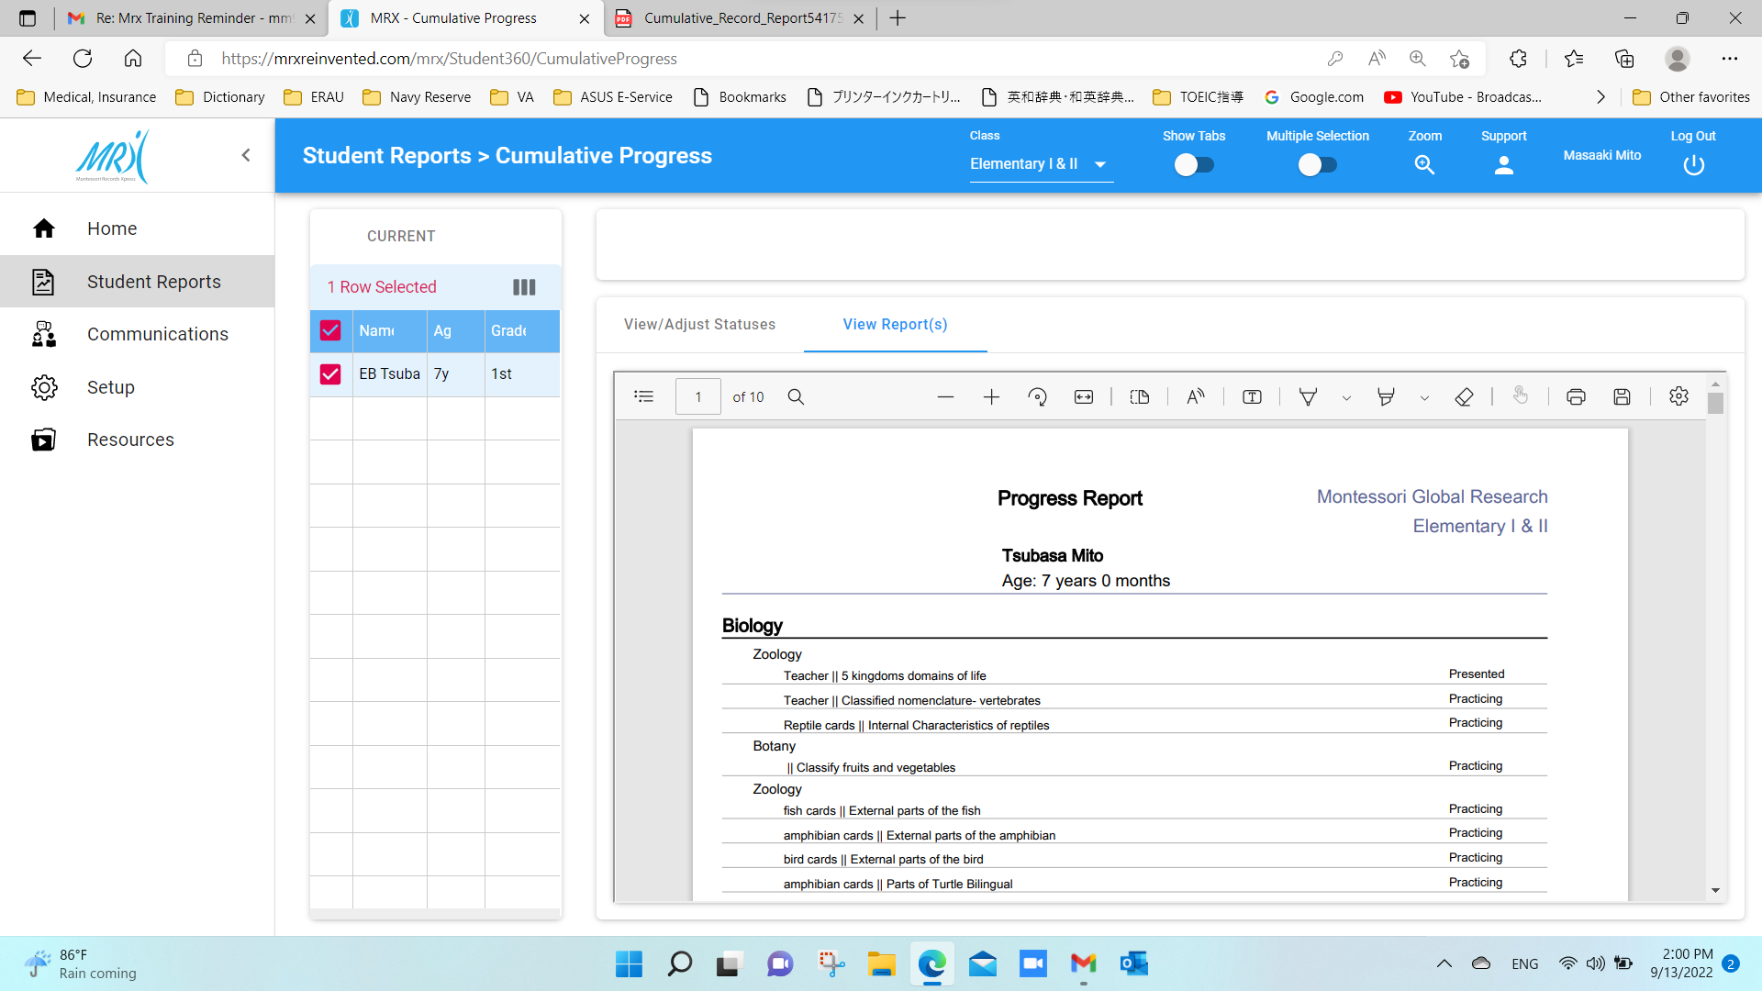
You got it!

Slide 22
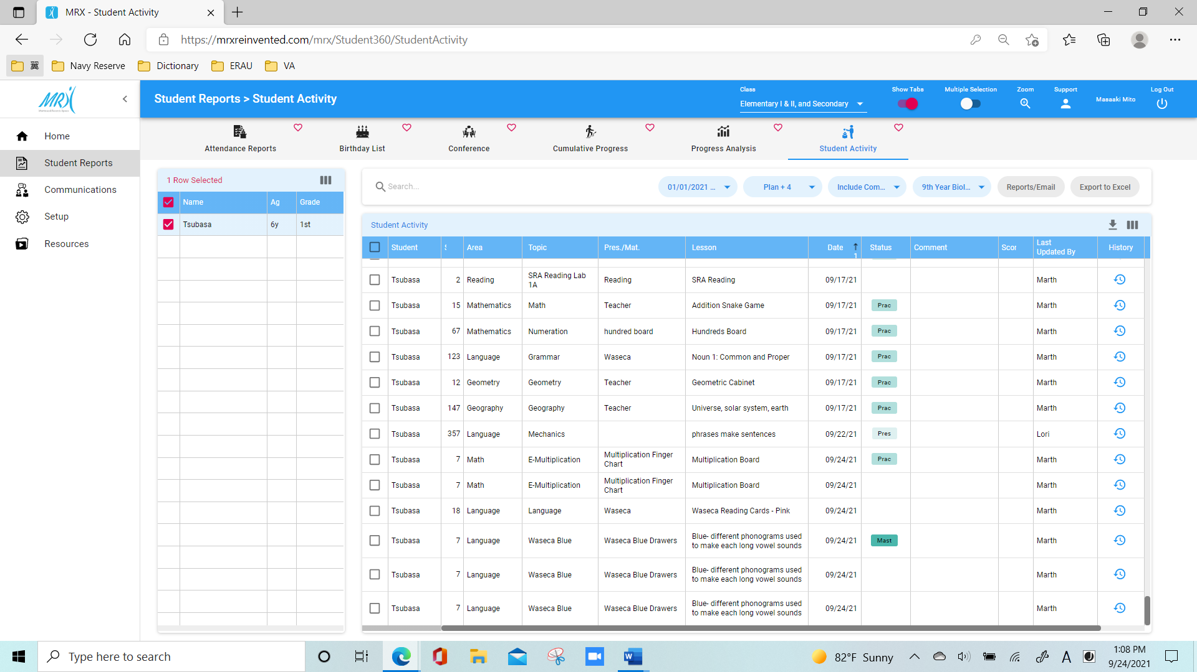
Student Activity & Video Library

Slide 23
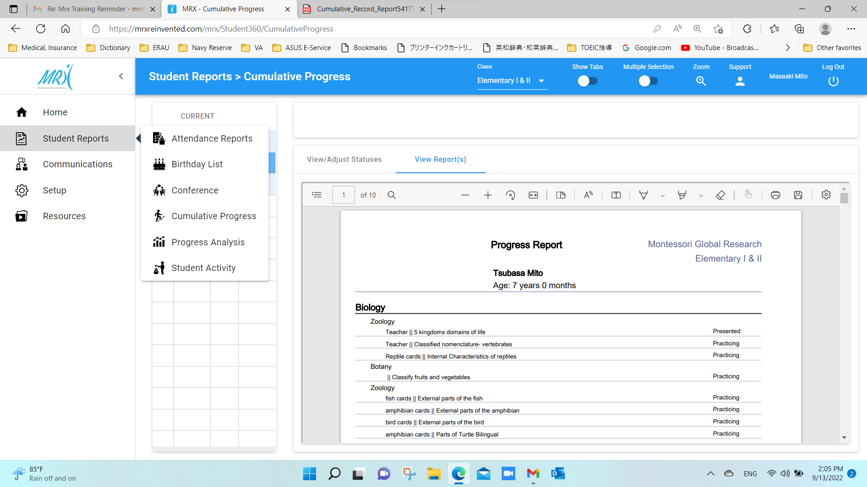
Mouse over
Click

Slide 24
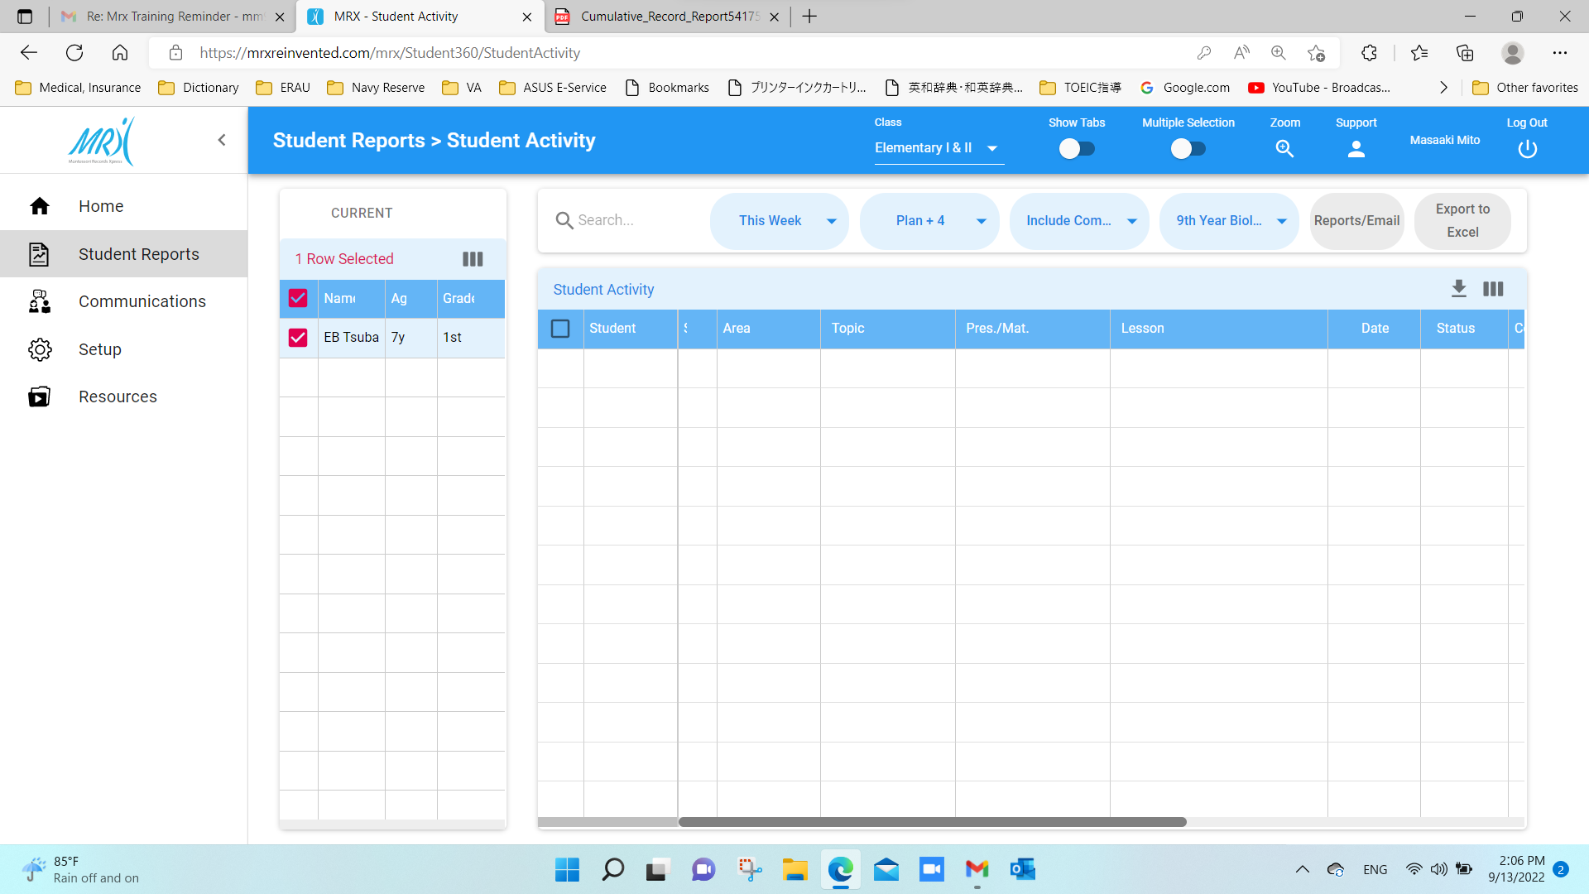
Click

Slide 25
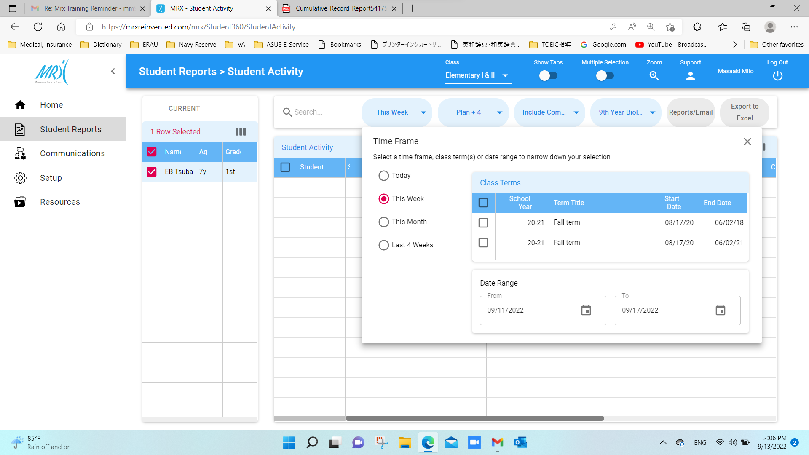
Click

Slide 26
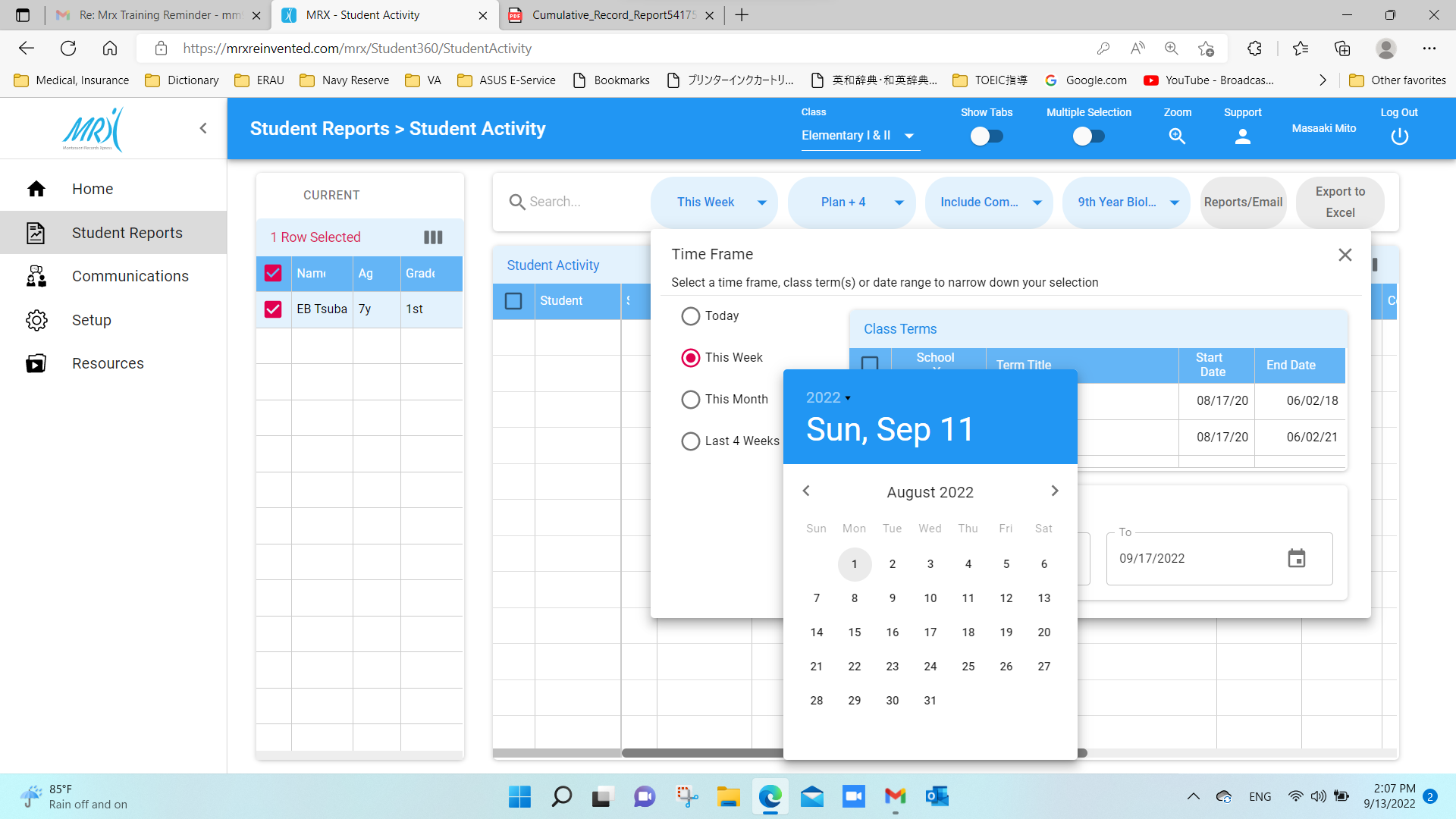
Click on “From” date

Slide 27
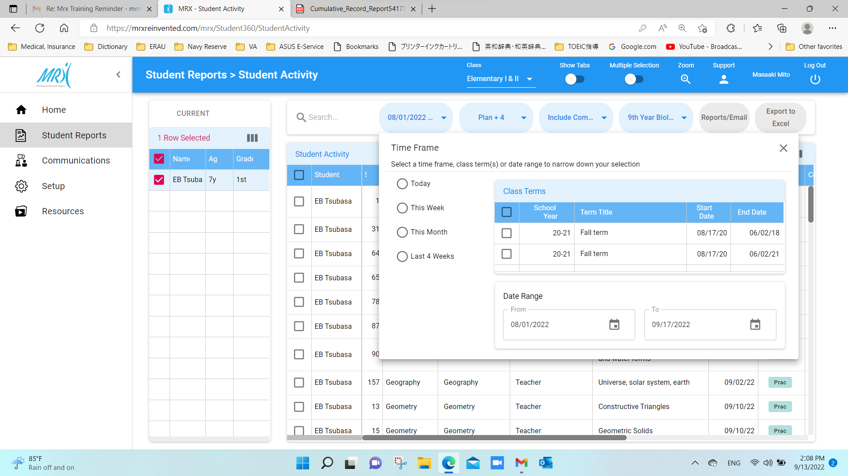
Activities in the chosen period is automatically uploaded.

Slide 28
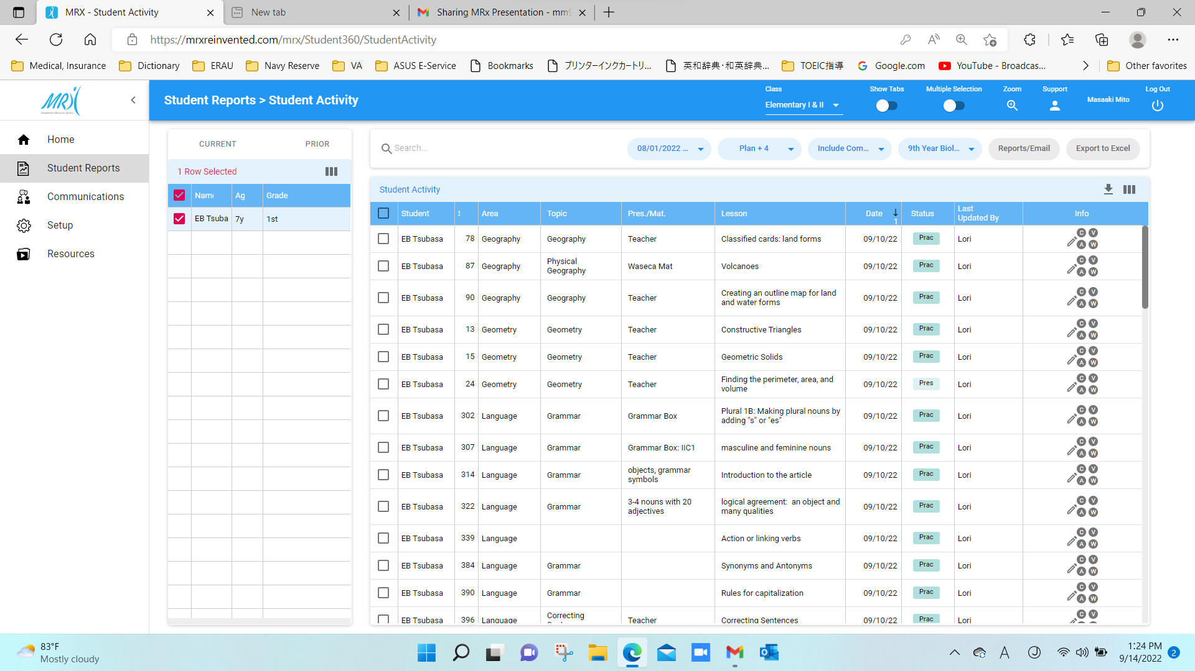
Click to sort by Area, Date, Status, etc.

Slide 29
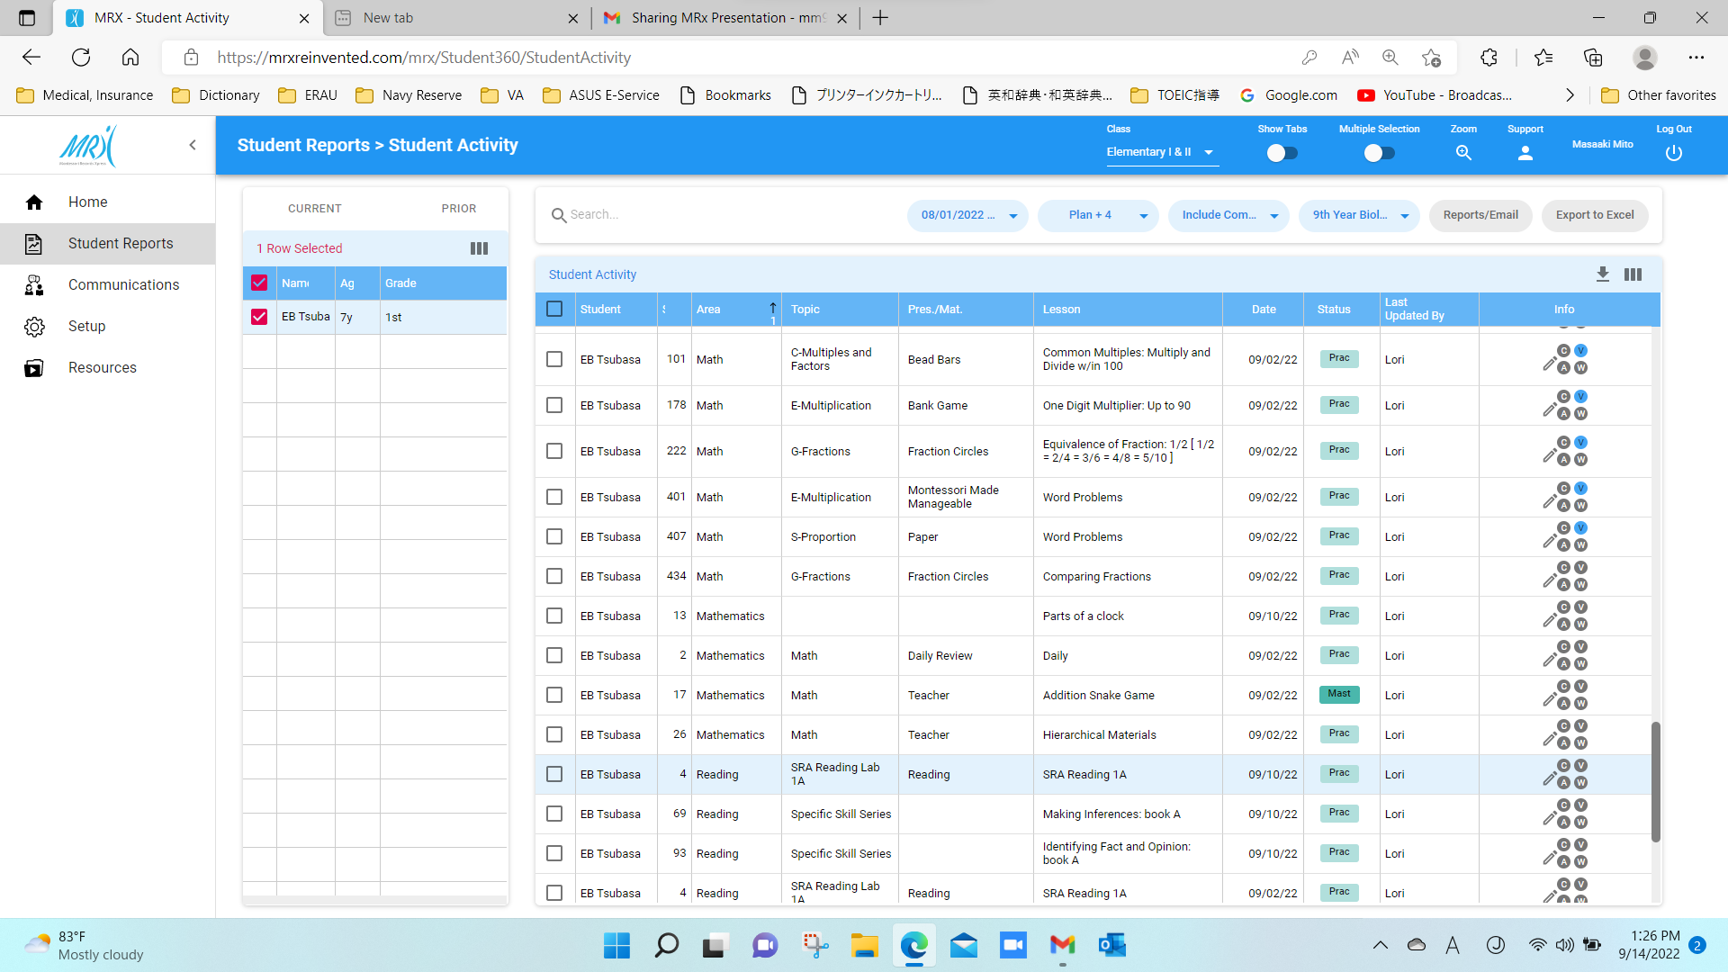
Click on “blue V circle” to see the lesson video

Slide 30
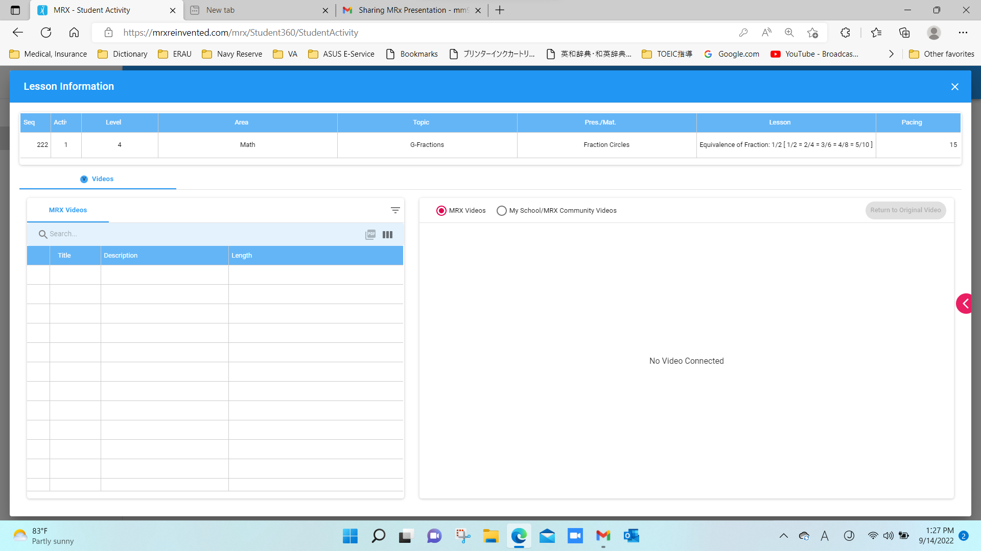
Click Videos

Slide 31
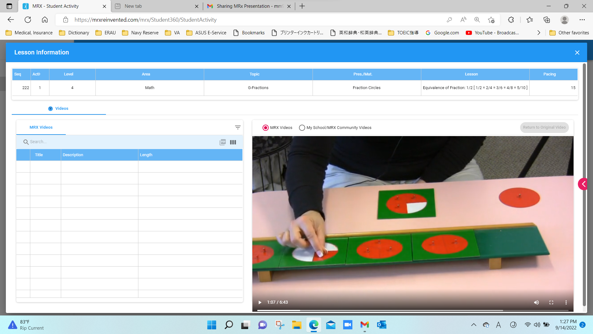
Video plays.

Slide 32
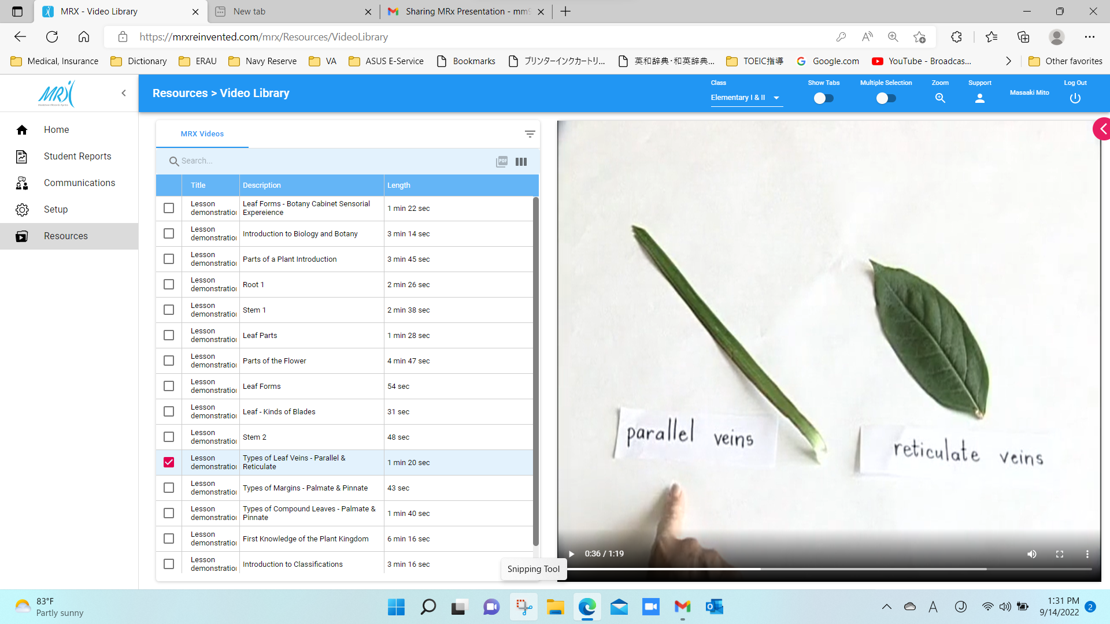
Click “Recourses” to go to the Video Library and check more videos.

Slide 33
Contact and Support

Slide 34
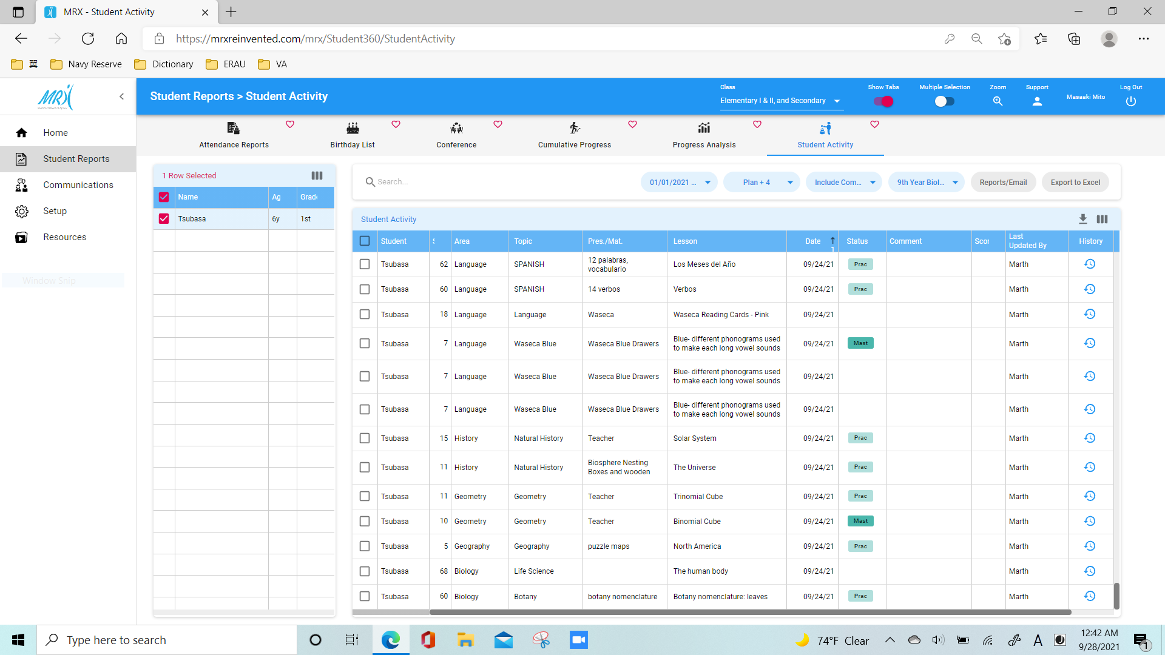
Click

Slide 35
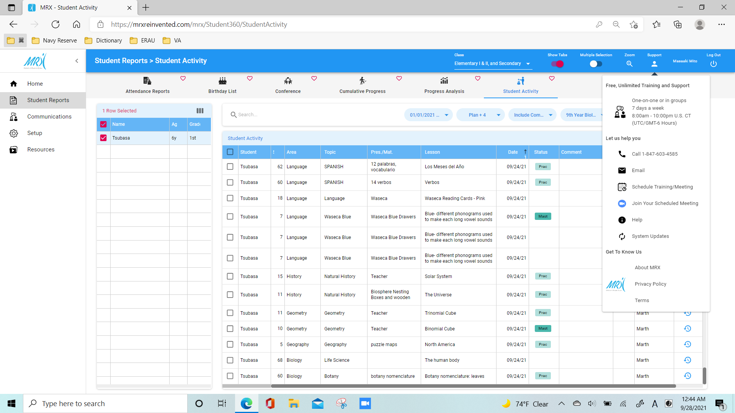
Customer Support

Slide 36
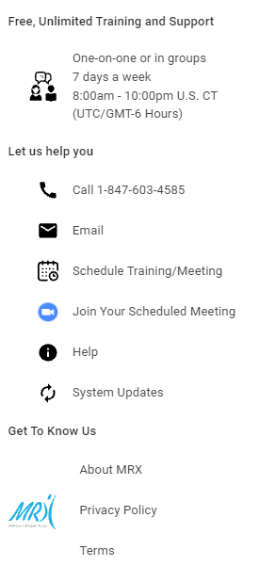
You can set a personal training session with a MRX Technical Support Representative.

Slide 37
Contact and Support
Dave Rabkin (MRX Technical Support)
Phone: (847)603-4585
Email: drabkin@montessorirecordsxpress.com
Sophia Dorman (MGRI Admin)
Phone: (386)492-7165
Email: admissions@montessoriglobalri.com
Masaaki Mito (Elementary)
Cell Phone & Text: (386)333-8661
Email: mm99now@gmail.com
Angely Ramirez (Primary)
Cell Phone & Text: (386)338-5062
Email: angieramirez86@gmail.com
Call or text us for anything, anytime!

Slide 38
MRX Summary:
You can see all lessons presented to your child and the statuses.
It connects classroom to parents, anytime, anywhere!

Slide 39
[Opinion]
With MRX, we can help our children and the school more effectively, because we have access to the most updated and detailed lesson report.
What are your thoughts? We look forward to speaking more with you about the lessons and how our kids are learning from them!
Thank you, please reach us anytime!

